Slide 1

Case Study
ITVEDANT EDUCATIONS
DBMS Queries.

Slide 2
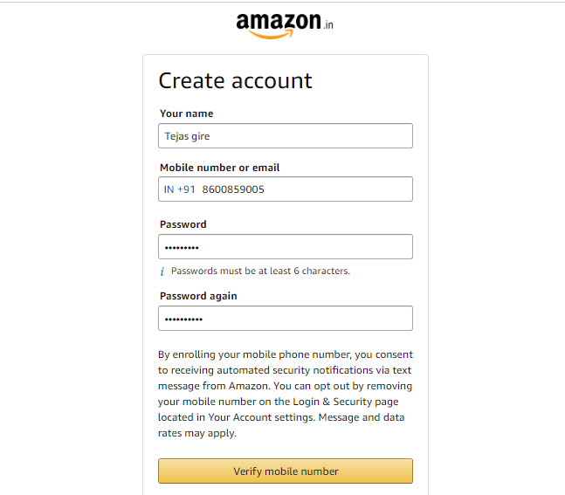
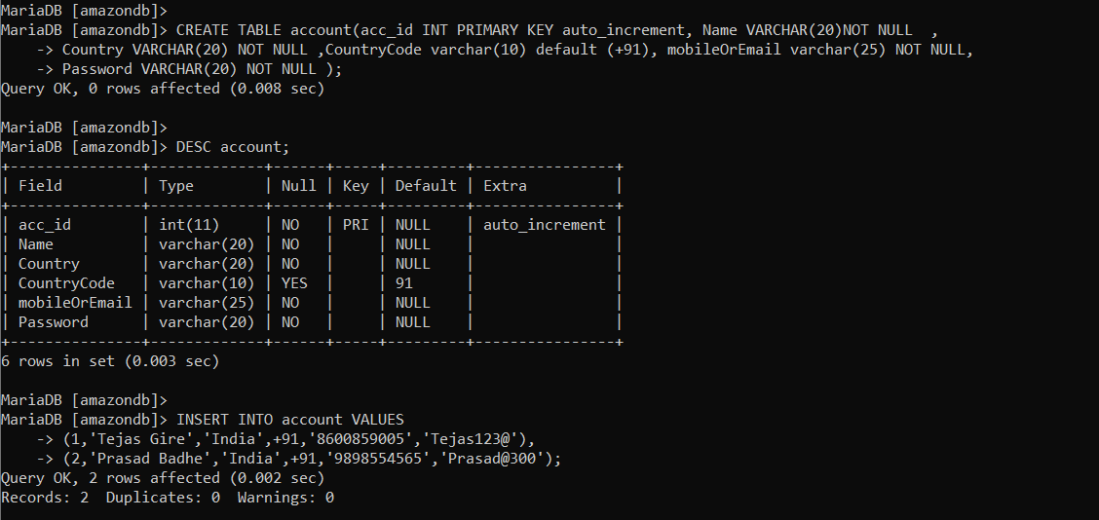
Create table, Insert values for Sign up new Account
CREATE TABLE account( acc_id int PRIMARY KEY auto_increment, Name varchar(20)NOT NULL , Country varchar(20) NOT NULL , CountryCode varchar(10) DEFAULT (+91), mobileOrEmail varchar(25) NOT NULL, Password varchar(20) NOT NULL );
DESC account;
INSERT INTO account VALUES (1,'Tejas Gire','India',+91,'8600859005','Tejas123@’),(2,'Prasad Badhe’ , 'India’ ,91 , '9898554565’ ,'Prasad@300’ );

Slide 3
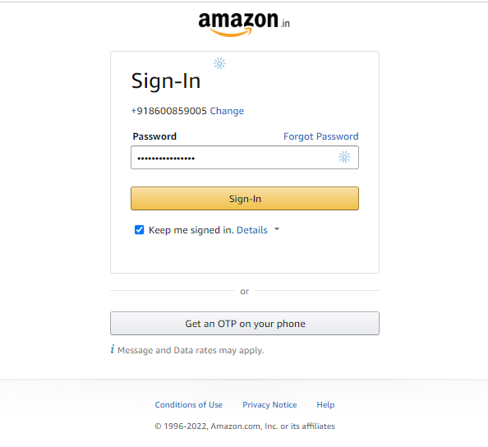
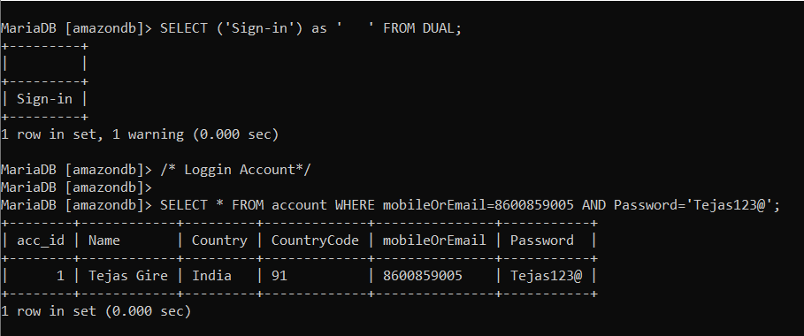
Sign in user Account using Select mobile no and Password
SELECT * FROM account WHERE mobileOrEmail=8600859005 AND Password='Tejas123@';

Slide 4
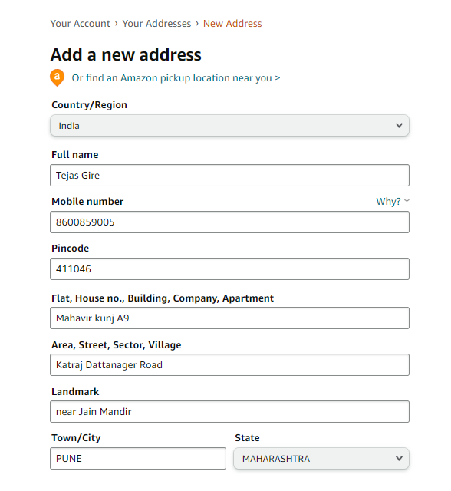
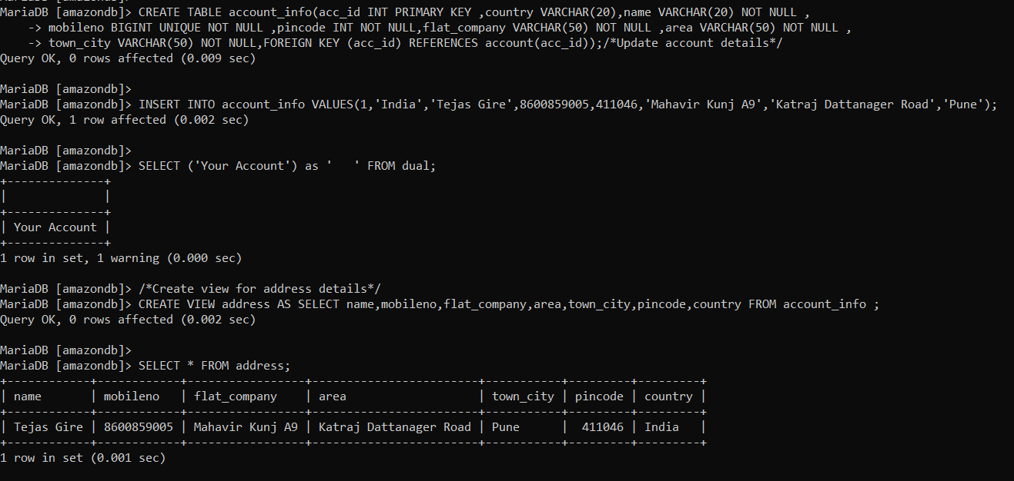
Create table account_info Create Simple View address,Constraints,
CREATE TABLE account_info(acc_id INT PRIMARY KEY ,country VARCHAR(20),name VARCHAR(20) NOT NULL , mobileno BIGINT UNIQUE NOT NULL ,pincode INT NOT NULL,flat_company VARCHAR(50) NOT NULL ,area VARCHAR(50) NOT NULL , town_city VARCHAR(50) NOT NULL,FOREIGN KEY (acc_id) REFERENCES account(acc_id));
INSERT INTO account_info VALUES(1,'India','Tejas Gire',8600859005,411046,'Mahavir Kunj A9','Katraj Dattanager Road','Pune');

Slide 5
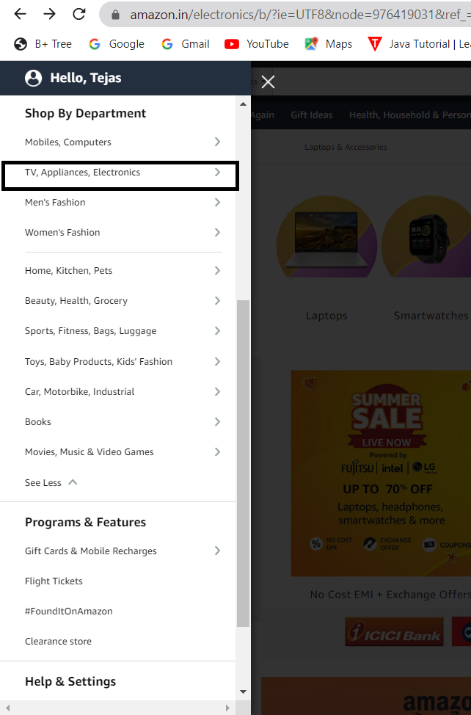
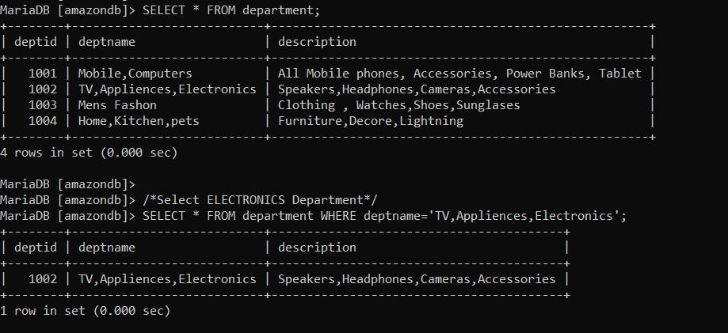
View Departments and Sorting Electronics Department
SELECT * FROM department;
SELECT * FROM department WHERE deptname='TV,Appliences,Electronics';

Slide 6
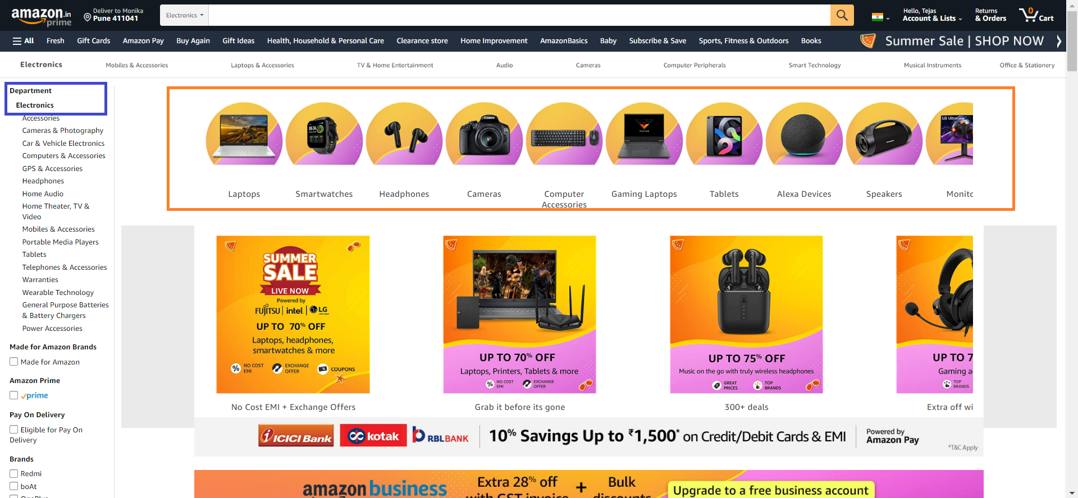
Watch Electronic Departments with Products

Slide 7
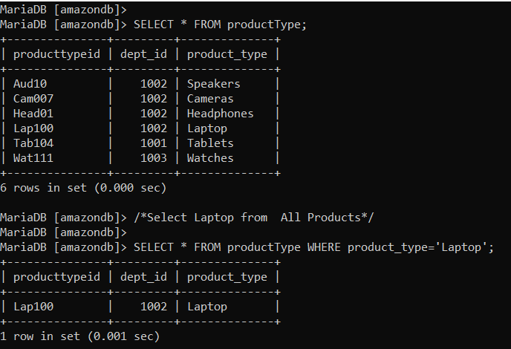
Sorting and Select Product Laptop
SELECT * FROM productType WHERE product_type=‘Laptop’;

Slide 8
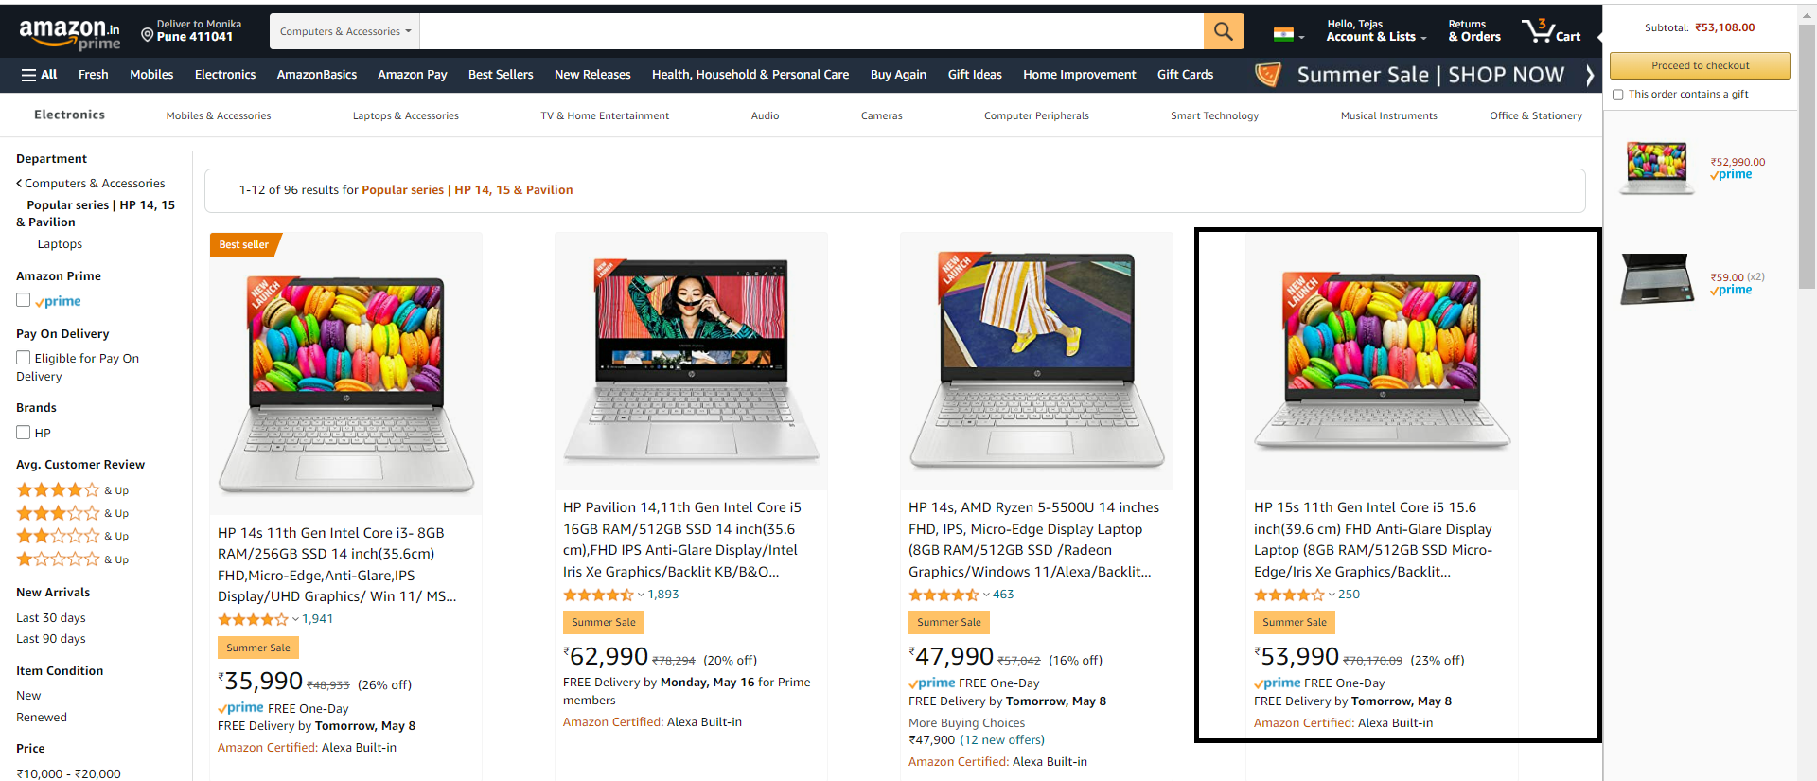
List of Laptop and Choose one Whose rating is greater

Slide 9
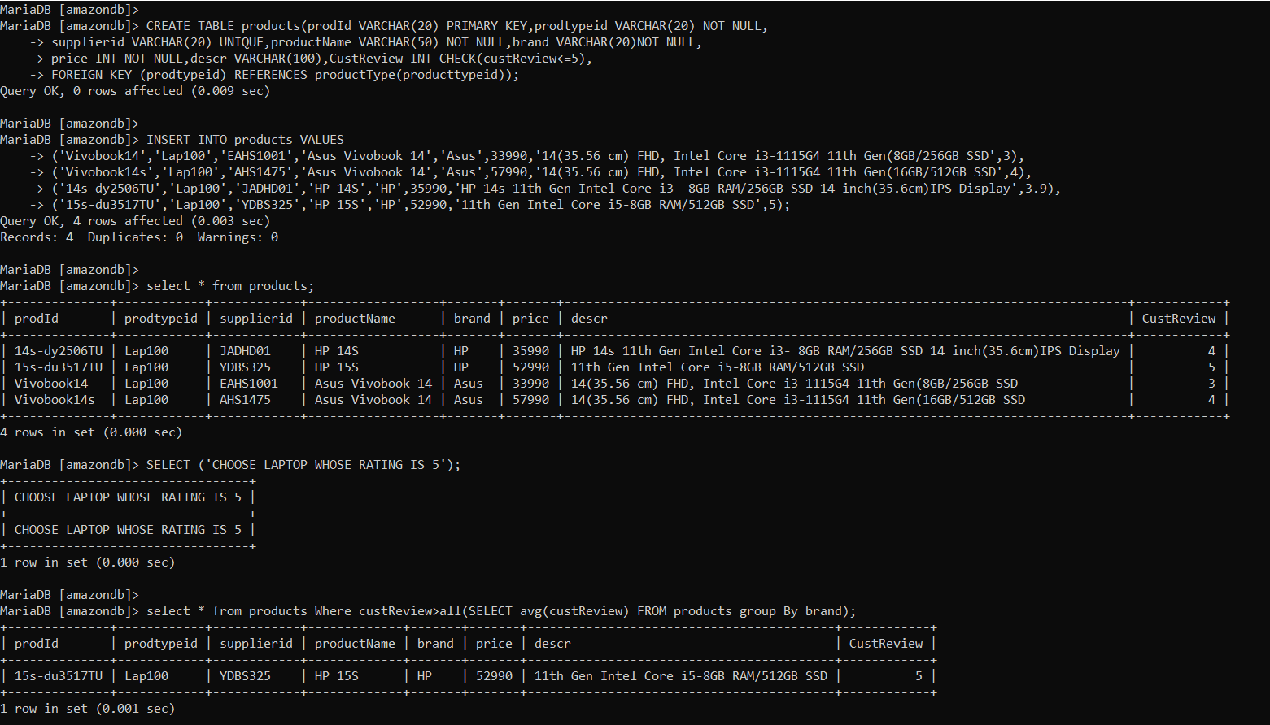
SubQuery to Choose Laptop

Slide 10
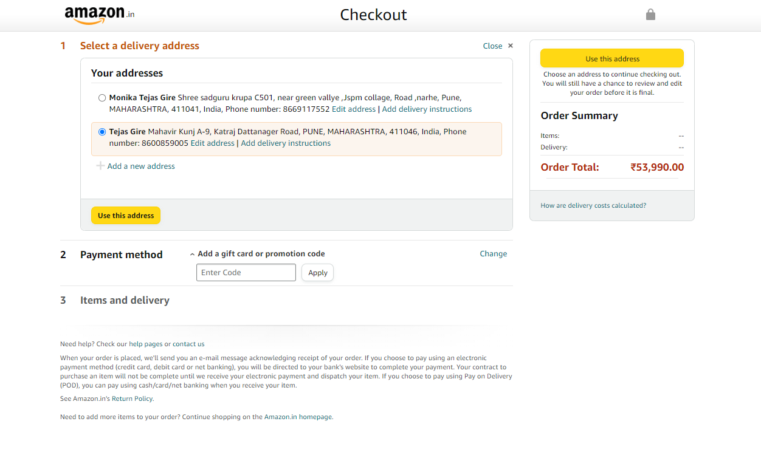
Order Details

Slide 11
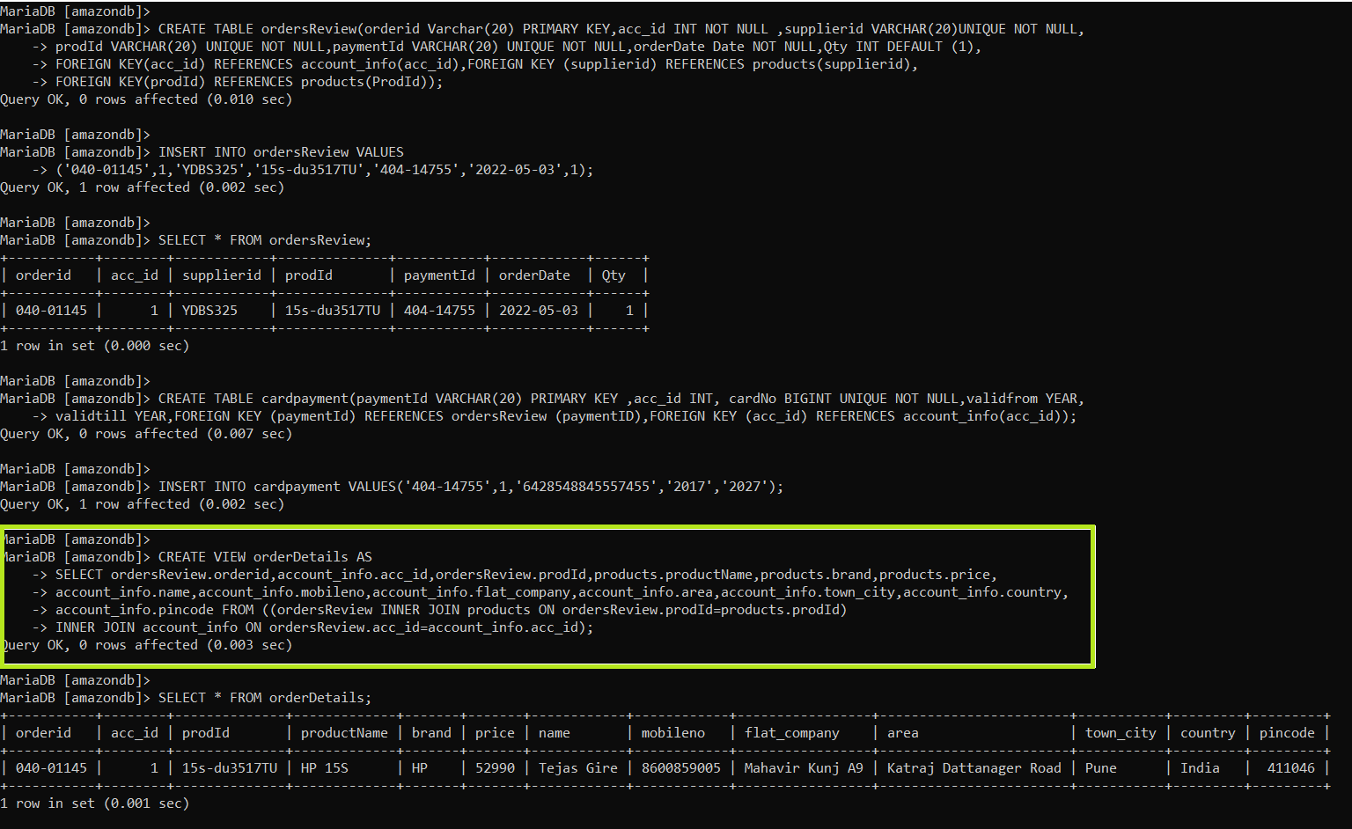
Create a Complex View with Three Tables Joining to View Order Details

Slide 12
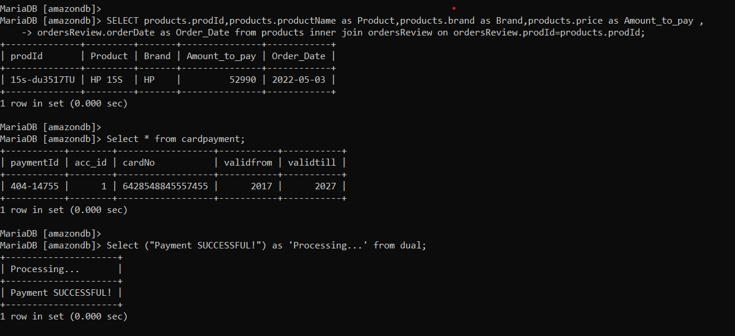
Query for Payments Joins

Slide 13
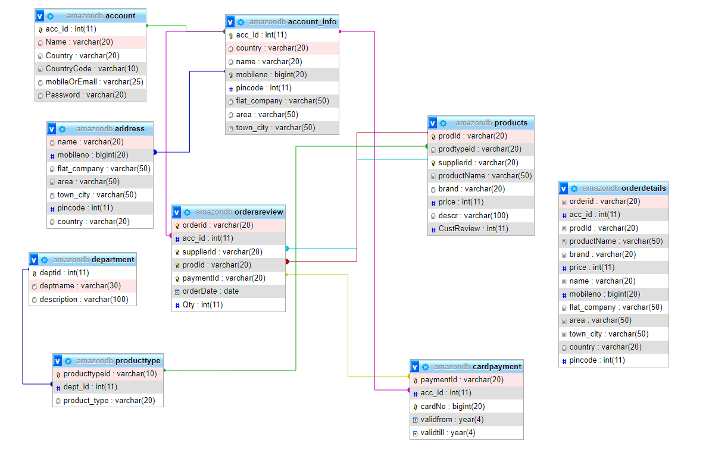
ER Diagram

Slide 14
Thank You

